Slide 1
Marsh, Downland and Weald: Monastic foundation and rural intensification in Anglo-Saxon Kent
Gabor Thomas
University of Reading

Slide 2
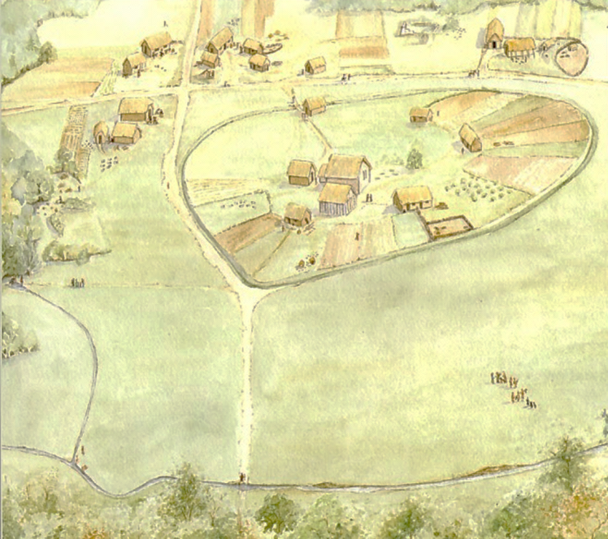
Monastic role in rural intensification
Tied labour-force of slaves/bond (600 working brethren at Wearmouth/Jarrow)
Stable centres of lordship – inalienable endowments with permanent complexes of core buildings
Core of monastic estates formed intensively exploited inlands. Emphasis on agriculture as a form of estate income as opposed to cash income and commuted food rents.
Augmented by scattered (outfield) dependencies ‘an archipelago of rights to tribute’ offering vital resources.
Beyond economics. To what extent did new Christianised perceptions of the natural world and its resources allow such changes to happen?
‘Scale of the their endowments, the coherence of their estate organisation and in the special needs that drove [monastic communities] to intensify production and generate surpluses’ (Blair 2005, 254).
Notes:
In what ways were monastic institutions predisposed towards innovations in land-management and estate organisation? All too easy to imagine that monastic establishments were parachuted fully developed into the Anglo-Saxon landscape
Pioneered a more organised, intensive and technologically innovative land-management regime

Slide 3
The dynamics of rural intensification
To what extent did the structure of early royal estates influence the economy of minsters endowed from them? (Faith 1997, 28)
Continuity: monasteries tapped pre-existing supply networks (customary food renders) embedded in the workings of royal estates; exploited broadly the same landscapes and environmental niches as their royal predecessors
Change
Patterns of consumption
Land-management/rural exploitation/estate infrastructure
Christianised perceptions of the natural world and its resources
Notes:
We hear a reasonable amount of detail of the territorial and economic infrastructure of estates bestowed by kings to newly founded monastic communities.

Slide 4
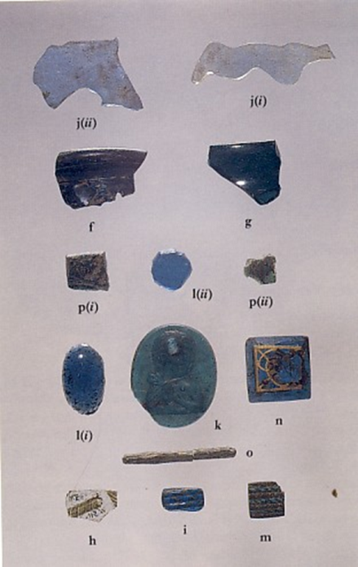
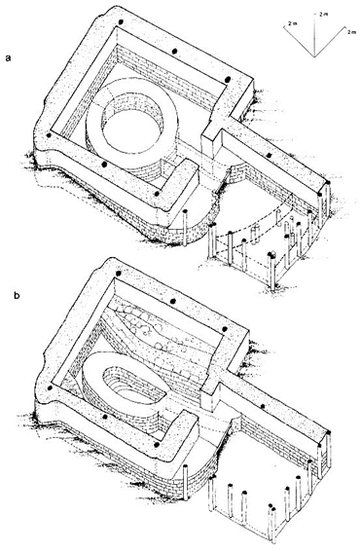
Assessing the archaeological contribution
Emphasis on the technology of craft specialization
Only infrequent glimpses on the technology of rural production
Hartlepool Whitby
Hoddom grain drying

Slide 5
Weaknesses in current archaeological data
Previous work weighted heavily towards core buildings at the expense of outer precincts – the main domestic/economic zones of monastic complexes
Sample of excavated sites geographically skewed towards Northumbrian/Northern Britain
Sampling of zooarchaeological, archaeobotanical data often poor leaving serious gaps in understanding – e.g. fish remains
Poor conception of the impacts of monastic foundation upon existing technology/rural infrastructure – the dynamics of monastic foundation
‘our archaeological knowledge of all but a few minsters is still restricted to tiny keyholes at most’ (Blair 2011, 733
‘we lack the commensurate archaeology of the peripheral zones of monasteries and their attendant settlements’ (Loveluck 2005, 245).
Notes:
The situation is epitomised in Kent.

Slide 6
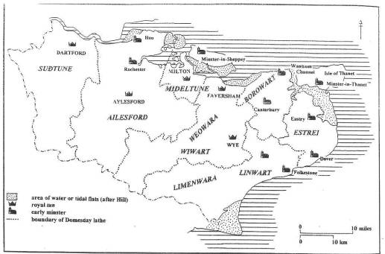
Kentish perspectives
Wihtred’s charter (AD 699) | Domesday Monachorum
Sts Peter/Paul, Canterbury | St Augustine’s, Canterbury
Reculver | Christ Church, Canterbury
Lyminge | Lyminge
Minster-in-Thanet | Minster-in-Thanet
Folkestone | Folkestone
Dover | Dover
Minster-in-Sheppey | ?Eastry
Hoo | Maidstone
 | Milton
 | Charing
 | Teynham
 | Wingham
 | Wye
One of the best documented monastic provinces in pre-Viking England
Good level of economic detail contained in charter sources
Long-term stability of Kentish royal centres means that we can examine monastic foundation and associated processes as a dynamic phenomenon
Notes:
This situation is particularly lamentable given that Kent represents one of the best documented ecclesiastical provinces in pre-Viking England. Unlike other regions of Anglo-Saxon England, historical sources can provide a fairly detailed characterisation of the early Kentish church offering rich opportunities for inter-disciplinary research and contextualisation of known sites.
In a charter of 811 for Eastry in Kent, Arch Wulfred states that he gathered small land-units together and formed them into one estate enclosed by a single boundary fence, so that they will be easier to administer and cultivate’.
Minster-in-Thanet involved in trade between London and northern Frankish ports – commercial activities of the Thames minsters look like that of better-documented counterparts along the Seine. Surpluses sold by minster comprised both agricultural bulk products and more specialised commodities – lead, iron, salt, quarrying, monastic specialities of making luxury ecclesiastical items.
Pasture by the name of ‘Romney enclosure (Rumining seta) for 300 sheep given to the minster of Lyminge by King Wihtred in AD700. Most of the 8th and 9th century charters relating to Romney Marsh came from the archives of the double minster of Lyminge.
Northern Frankia – Sited at existing royal villa. They had a landed patrimony, that, from the moment of their foundation, was usually endowed with production centres and already exploited by those peasants/slaves who had been given with it. Granted coastal estates providing extensive stock-raising, salt production and fishing/trading sites.

Slide 7
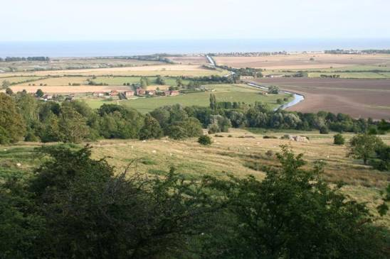
Economic glimpses in charter sources
Trade - involvement of Kentish double-minsters in long-distance exchange networks – toll remission charters
Land-management
Exploiting outlying resources: saltmarsh grazing, salt production, fishing, iron industry
Consolidation of estates - Arch Wulfred ‘gathered small land-units together and formed them into one estate enclosed by a single boundary fence, so that they will be easier to administer and cultivate’. (AD811)

Slide 8
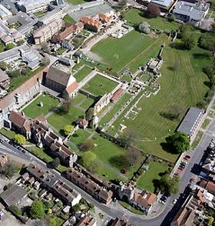
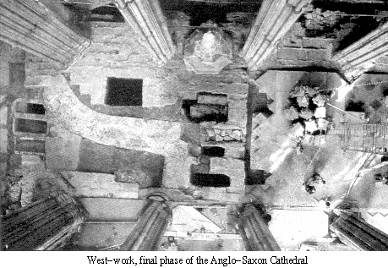
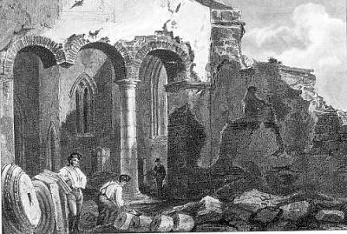
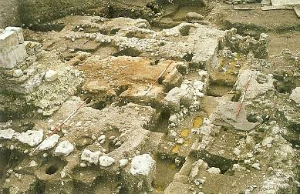
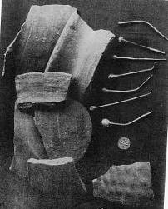
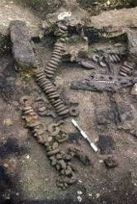
Previous work in Kent
St Augustine’s, Canterbury
Reculver
St-Mary-Le-Grand, Dover
Notes:
The Lyminge project represents an attempt to redress the balance in the particular socio-political context of Kent - a region crucial to the earliest stages of the AS conversion and one of the founts of early English monasticism.
If we look at previous in the region we can see that it epitomises many of the problems noted nationally: keyhole glimpses, focus on cores and urban minsters. It is something of a paradox that whilst Kent with its impressive ecclesiatical heritage is central to public and academic perceptions of the beginnings of Anglo-Saxon monastic culture, we know remarkably little about how life was organised in its earliest monastic institutions from a material perspective.

Slide 9
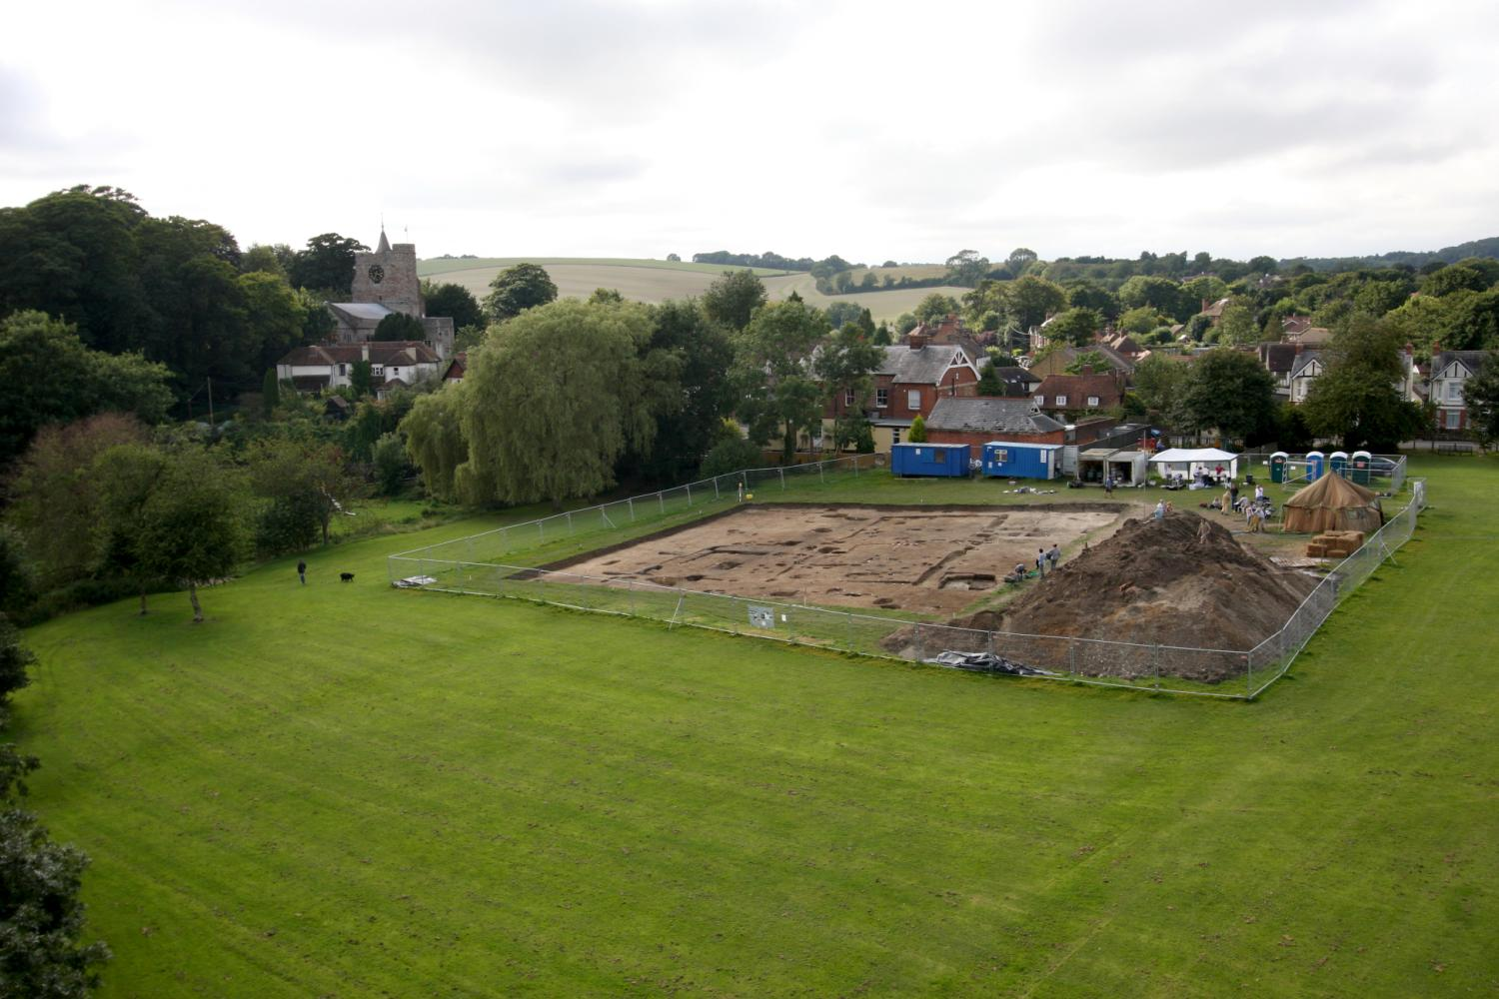
Introducing Lyminge as a new case-study
Notes:
President, Fellows and guests, it is a great pleasure to be able to speak to you from this platform about my on-going research at Lyminge, Kent. Not least, it provides me with the opportunity to record my personal gratitude to the Society for its generosity in providing funding for the 2010 excavations and for a subsequent phase of preliminary post-excavation analysis, the results of which I will be drawing upon in various parts of my talk. But the debt of gratitude goes back further than that, for the Society was also a generous supporter of my previous research at Bishopstone, an exercise in village core archaeology targeting Anglo-Saxon antecedents, which provided the perfect training-ground for its more ambitious successor. Today’s platform also happens to be particularly timely, for it falls at the cusp of an energetic and exciting new phase in the evolution of the Lyminge project spurred by a major grant from the AHRC in June to support a further 3-year campaign of research and excavation. This fresh investment has already begun to pay dividends, as some of you may have seen from recent media coverage of major new Anglo-Saxon remains uncovered in this summer’s inaugural campaign, on which more later.
I want to start my talk by considering the wider academic context framing the Lyminge project before providing a synopsis of its results structured as a chronological narrative spanning the late 5th to the 9th centuries AD. The key point that I want to demonstrate in today’s talk is the potential that Lyminge holds as an archaeological case-study for examining the social dynamics of monastic foundation in Anglo-Saxon England.

Slide 10
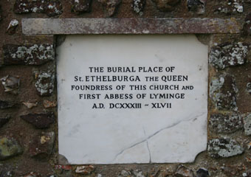
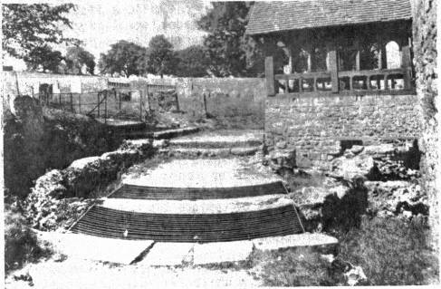
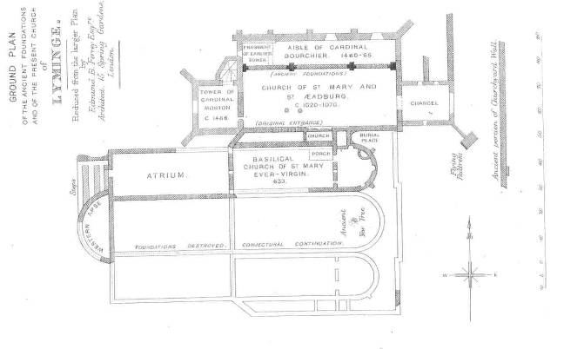
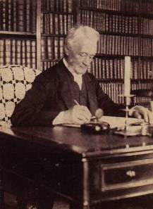
Antiquarian research
Notes:
The foundation of a monastic community at Lyminge is traditionally ascribed to the A-rated historical figure of Queen Ethelburga, widow of Edwin of Northumbria and daughter of Ethelberht of Kent. Actually, as S.Kelly has shown, this is based on some rather shaky evidence contained in a body of post-Conquest hagiography known as the Mildreth legend produced in Canterbury in a climate of bitter rivalry between St Augs and CC over the relics and endowements of the Kent minsters. Although the local residents visibly shudder when I say this, it is unclear whether the relics venerated at Lyminge before being carted off to St Gregs priory under the instructions of Archbish Lanfranc were those of an Ethelburga, let alone the Ethelburga of Bede’s narrative. Equally problematic is the suspicuously early foundation date of AD633. Kelly has proposed that could have started life as a royal mortuary chapel refounded as a double community in the later 7th. This supposition is strengthened by archaeological results in 2012.
The latter-day cult of St Ethel (of which there are multiple memorabelia in the village) rests upon the shoulders of Canon Jenkins, rector of Lyminge in the 1850s and 60s. The model of a Victorian cleric-scholar and well informed of Lyminge’s historical associations, Jenkins dedicated himself to the task of recovering the former glory of Lyminge and its illustrious foundress through a concerted campaign of excavation in and around the churchyard. Jenkin’s somewhat inflated interpretation of those remains uncovered has caused a long-running debate over the SW portion. What is not in doubt is that foundations to the south of the nave represent a 7th-century chapel bearing the construction hallmarks of the Augustian mission, paralleled at Canterbury and Reculver.
The foundations to the SW are more difficult to interpret. Not a Roman bathhouse, 4 phases of AS construction. A later addition to the church? The AHRC-funded phase of the project will improve understanding of the core buildings using a 3 pronged attack: 1) fund analysis and publication of work by TTB which re-investigated the SW foundations, undertake GPR survey within and without the footprint of the parish church, and to examine and transcribe the Jenkins archive held here at the Society.

Slide 11
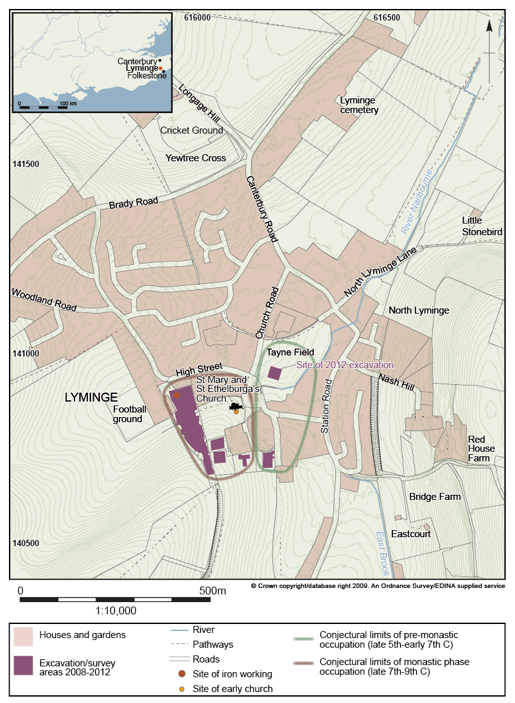
Results
Five seasons of open-area excavation, trial-trenching and geophyzz completed since 2008
Two distinct settlement foci, the earlier (late 5th-early 7th C) culminating in a ‘Great Hall’ complex
A localised ‘Middle Saxon Shift’, spatial redefinition of settlement around a monastic nucleus established in the later 7th century
Microcosm for investigating the social dynamics of monastic foundation and Christianisation in Anglo-Saxon Kent.
Notes:
Working towards a conclusion, let’s know summarise the key developments in the Anglo-Saxon occupation sequence preserved at Lyminge.

Slide 12
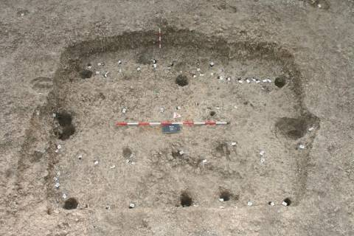
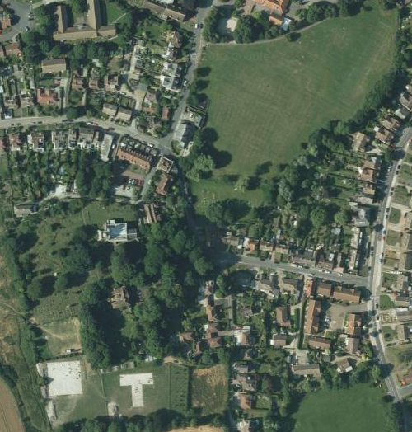
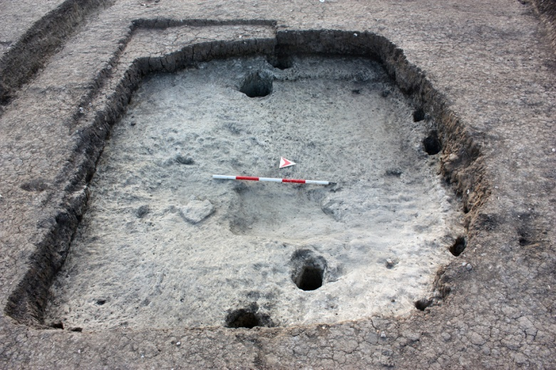
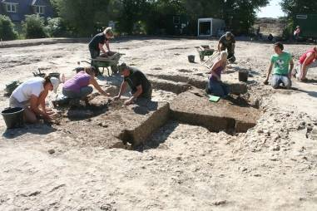
Early Anglo-Saxon settlement focus
Notes:
As a result of our excavations, Lyminge has the distinction of providing the first glimpses of what has long eluded archaeologists: the domestic settlement component of a Kentish royal vill. This early settlement focus occupies the lowest-lying portion of the village dissecting by the headwaters of the River Nailbourne with its springhead below a chalk spur capped by the church. Sampled in 2010 and 2012, this diffuse sprawl is represented by a classic combination of SFBs and post-built halls typical of migration-period settlements.

Slide 13
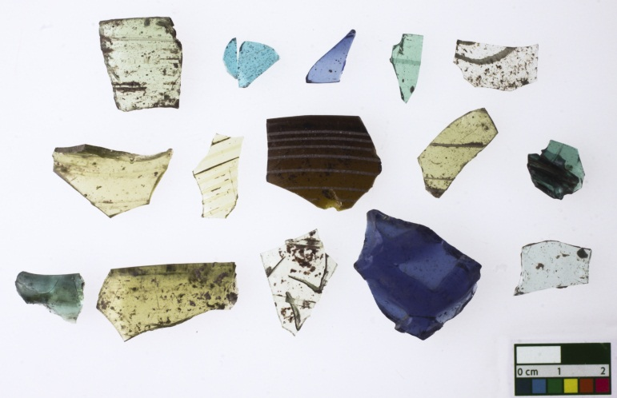
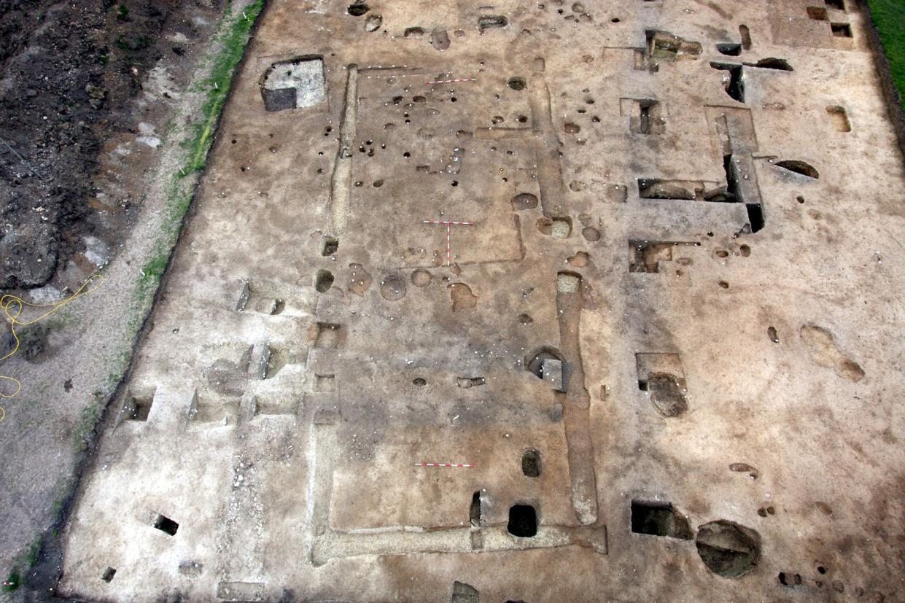
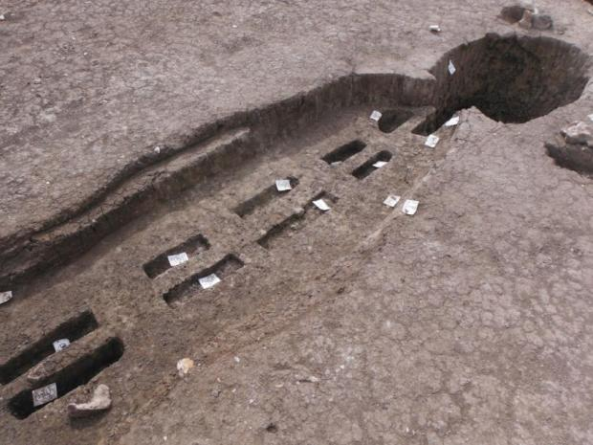
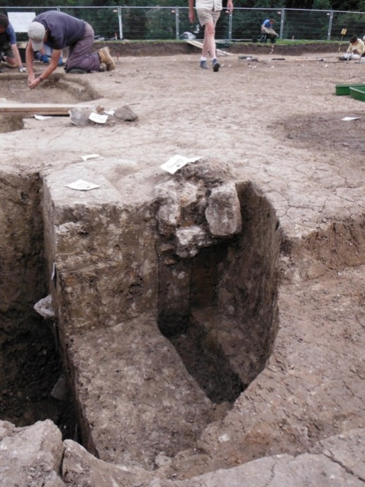
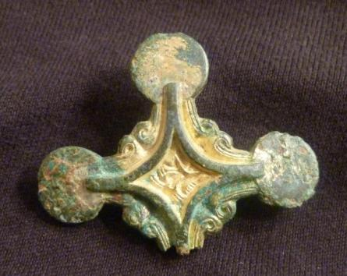
The Lyminge ‘Great Hall’
Notes:
Until 2012 it was really the character of the cultural assemblages which suggested that Lyminge in the 6th century was a focus for elite, perhaps aristocratic occupation. Spectacular onfirmation came this summer with the discovery of a Great Hall on Tayne Field, a low spur encircled by the Nailbourne and beside the Coach & Horses pub. Revealed in its totality, the ground-plan measures 21m long by 8.5m wide with an internal partition at the east end and opposed entranced mid way along the long walls. The hall is of post-in-trench construction employing parallel pairs of timber uprights cut into planks, with larger planks being used for the main doorposts.
In construction and monumentality, the hall shares clear affinities with the great halls uncovered at other excavated royal complexes of the 7th century, including CD, Yeav and SC. Like these sites, the complex of high-status halls at Lyminge was constructed within a pre-existing settlement stretching back into the migration period.
However there is one significant difference: whereas the other sites are very clean artefactually; Lyminge hall continues the theme rich cultural deposition seen in earlier SFBs. The result is direct archaeological insights into the social practices associated with the actual use of the halls – feasting and the symbolism of aristocratic display.

Slide 14
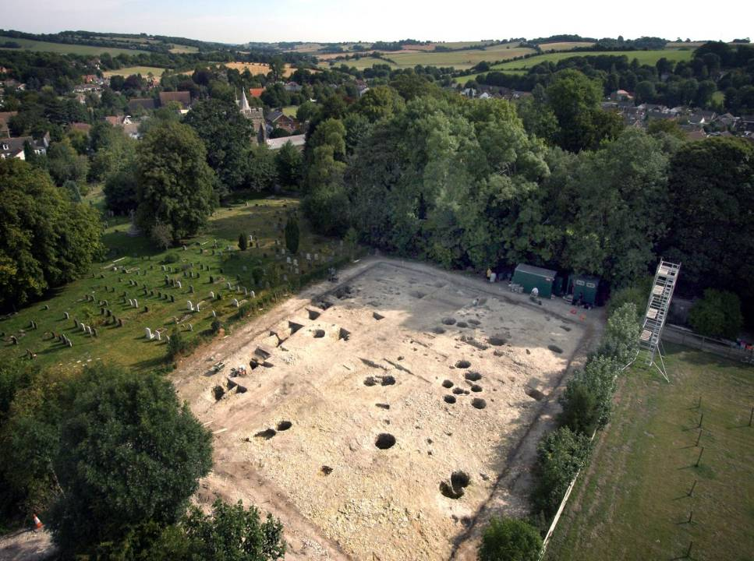
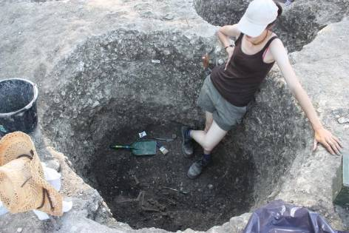
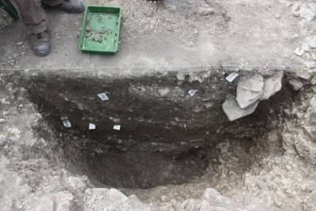
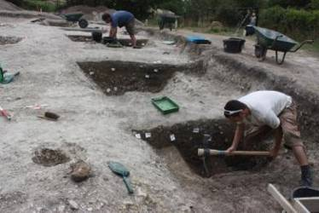
Monastic phase occupation

Slide 15
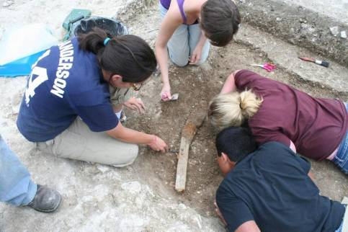
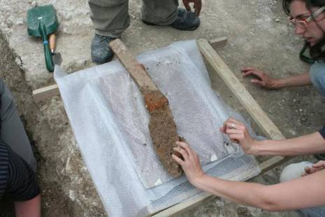
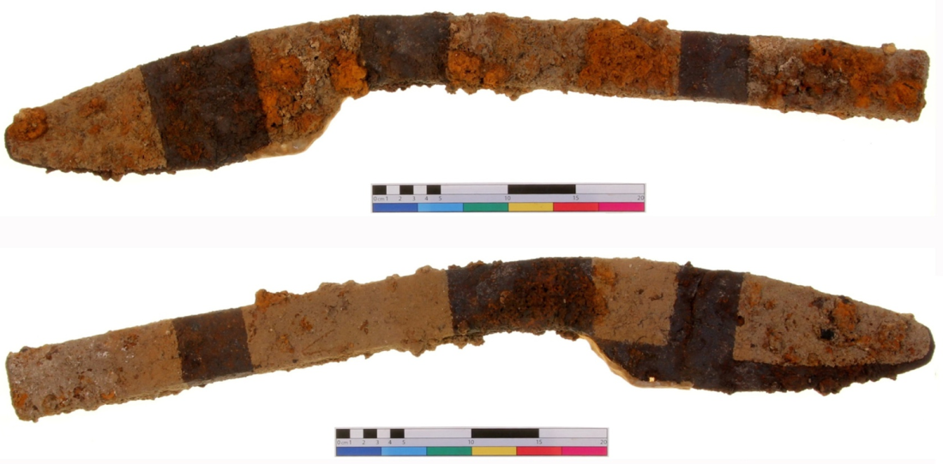
Agrarian technology in the 7th century
Notes:
Most remarkable of the wide array of artefacts discovered in 2010 was this magnificent plough coulter, the first of its type from Early Saxon England, whose deposition is firmly dated to the first half of the 7th century on the basis of C14 dating. However one wishes to interpret this object in terms of plough technology, it does suggest an economically pre-eminent household experimenting in innovative estate infrastructure influenced by continental Frankish traditions.
15

Slide 16
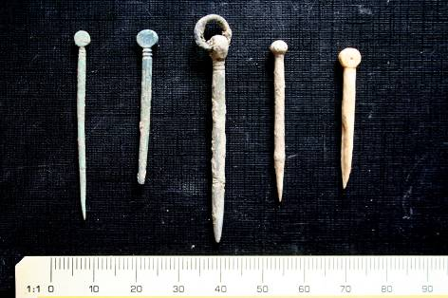
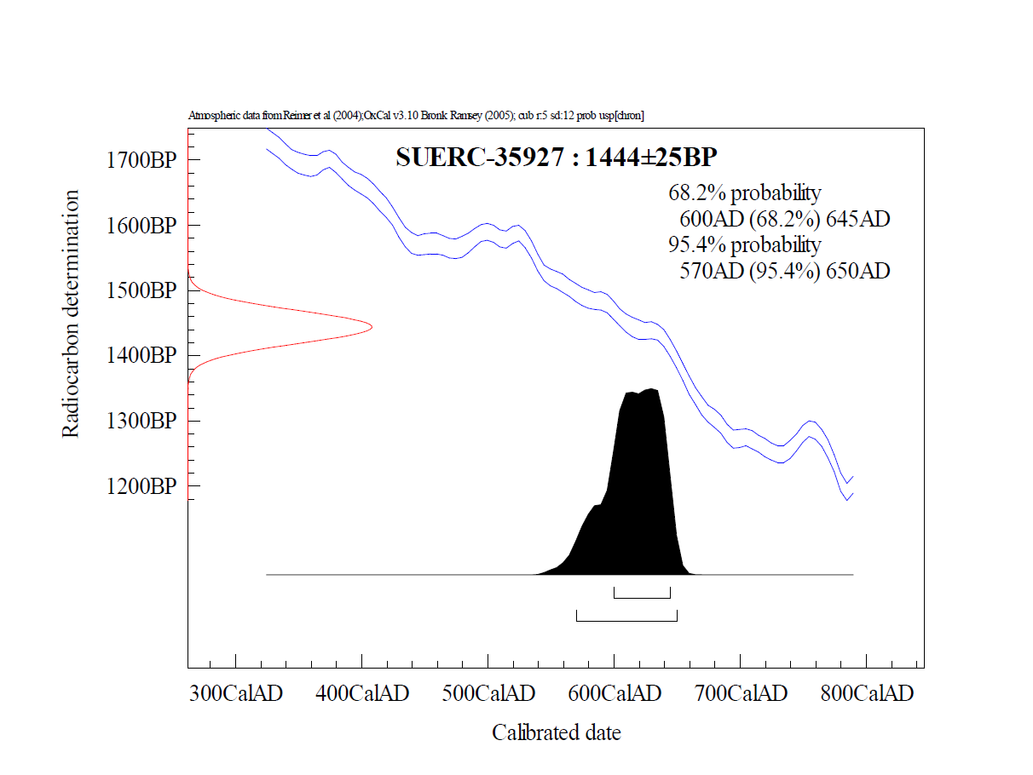
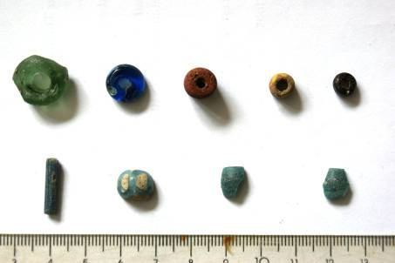
Date of deposition

Slide 17
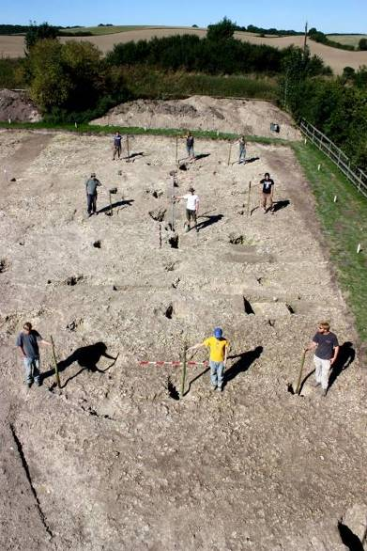
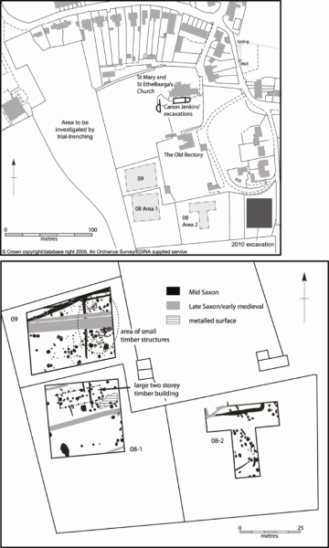
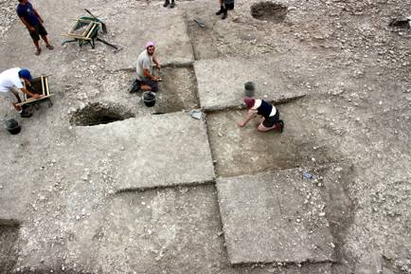
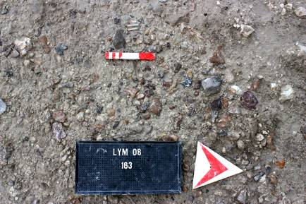
Innovations in monastic economy 1: agrarian surplus
The Lyminge ‘threshing barn’
Notes:
Evidence for activity on the periphery of the monastic settlement comes in two distinct forms, both providing vital insights into the workings of the monastic economy. The first is an posing E-W building, measuring 19.5 x 6.5m externally and with a central alignment of posts, almost certainly to be interpreted as a threshing barn.

Slide 18
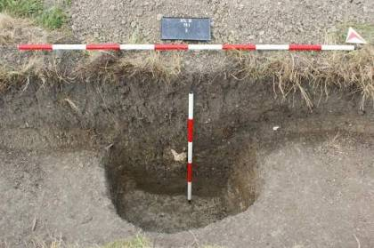
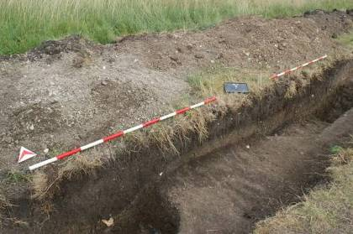
Innovations in monastic economy 2: Ironworking
AD 689 King Oswine grants to St Augustine’s, Canterbury, a sulung of iron-bearing land which had previously belonged to the cors at Lyminge
Notes:
Another activity located within the outer precincts was industrial-scale ironworking evidence for which was recovered in trial-trenching this summer. Takes the form of cluster of middle saxon pits filled with slag and recycled iron objects, presumably marking the site of the smithing operation associated with an extensive spread of slag shown up on geophyzz. This physical evidence can be linked to a royal charter dated 679 granting land with an iron mine formerly belonging to the royal vill at Lyminge to Christ Church - the earliest reference to iron-extraction rights in Anglo-Saxon England.

Slide 19
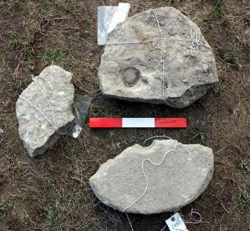
Crop husbandry signatures
occurrence of unusually abundant, very dense samples
the occurrence of rare, possibly cultivated species, such as opium poppy
relatively high quantities of glume wheat remains
relatively high proportions of oats among free-threshing cereal remains
Quern manufacture

Slide 20
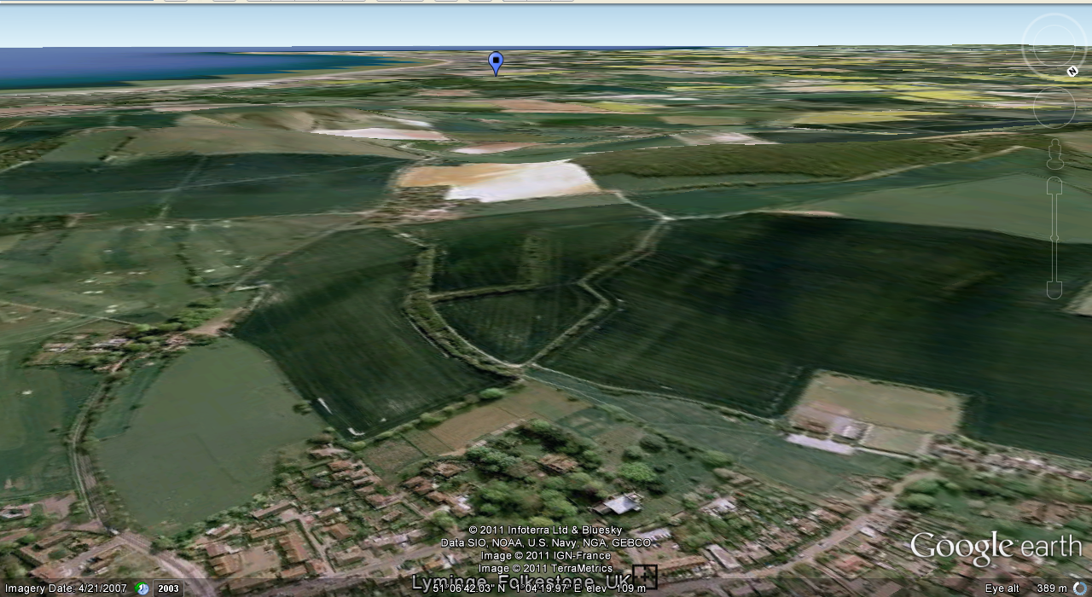
Intensification in supply networks: The Romney Marsh connection
Notes:
I now want to move away from the spatial characteristics of monastic planning to look more closely at insights gained by preliminary analysis of cultural and bioarchaeological assemblages recovered from the monastic-phase occupation. The potential of pits and ditches as traps for cultural and bioarchaeological material was maximised by a blanket policy of dry sieving of all stratified contexts together with extensive bulk sampling for on-site environmental flotation. As a result, Lyminge has generated some of the richest artefactual, zooarachaeological and palaeoecological assemblages form Middle Saxon England south of the river Thames. When combined with the extensive deposits gained from the early settlement focus, these assemblages provide a powerful tool for tracking diachronic changes in daily life between the 6th and the 9th centuries AD. I don’t have time to examine all of these strands today, so will instead confine myself to a selection which in their own way demonstrate Lyminge’s potential to chart the social dynamics of monastic foundation at a Kentish royal vill.
In this discussion I will be emphasising changing patterns of interaction with the wider world as crucial to shaping the cultural identity and material practices of Anglo-Saxon Lyminge over this period of crucial social transformation. In pursuing these themes there is clear potential to integrate a historical dimension in the form of charter evidence which documents in some detail the growth of the monastic endowment and its economic resources between the 7th and early 9th centuries AD.

Slide 21
The charter evidence
Charter | Location | Resources
S21 AD 700/715 | ?Pleghelmestun/Wilmington, Kent | Pasture for 300 sheep – ‘Rumining seta’
S23 AD 732 | Sandtun, West Hythe, Kent | Land with generous supply of fuel for saltmaking
S24 AD 741 | Broomhill, Kent | Fishing rights in the River Lympne

Slide 22
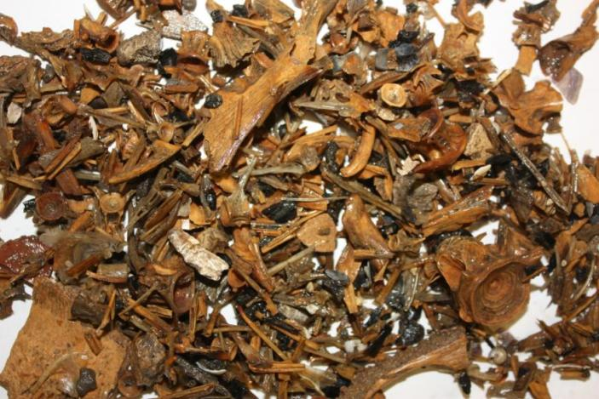
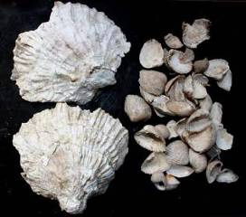
A turn to the sea: marine signatures
10,000s specimens - largest assemblage of fish bones from AS England.
8/9thC: rise to dominance of marine species - cod, ling, herring, flatfish, horse mackerel, sea bream - accounts for 35% of the hand-collected/dry sieved assemblage
By contrast 6/7th C contexts produced only relatively small numbers of inshore estuarine species, herring and flatfish
Upsurge in the exploitation of marine mollusca
Conclusion: a diversification in coastal fishing placing new emphasis on line-caught deep-water Gadidae (Cod, Haddock and Ling), but with continued exploitation of inshore/coastal estuarine species.
Notes:
Lyminge has produced a rich abundance of fish bone, particularly from the 8/9th c phases. This demonstrates a dramatic rise to dominance of marine species, large fish well represented in hand-collected/dry sieved assemblage. Bulk samples indicate that these catches supplemented smaller estuarine species, a food resource also represented in bulk samples from the early settlement focus. And here we may note that neighbouring village of Elham, makes a direct toponymic reference to the harvesting of such catches in local rivers and streams. An intensification in the exploitation of coastal habitats is also reflected in an upsurge in various species of marine mollusca collected from the monastic-phase occupation. Here we have unequivocal evidence for a shift to a marine-influenced dietary regime that could have very well been triggered by monastic food restrictions of the type laid out in the Rule of St Benedict.
The Whale and Beowulf, highlight a deep-rooted primal fear of watery environments and the creatures they contain (Pentz 2000:27; Cohen 2010:2-3). In many respects it can be suggested that watery places such as tides and marshes, as well as marine environments continued to represent liminal zones or a ‘blue wilderness’ during this period (Pluskowski 2010a:104; Price 2010:xv).
Life of St Wilfred ‘he arrived among the S.Saxons to find them starving because, although they caught eels, they did not know how to fish off-shore. Wilfred taught the people to use nets in the sea and ‘they soon took 300 fish of all kinds’.

Slide 23
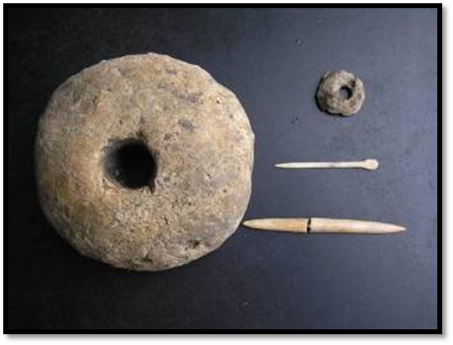
Transformations in animal husbandry
Notes:
Another diachronic pattern that could be similarly is a clear intensification in the consumption of domestic fowl evidently reared on site, a signature which Keith Dobney has recognised in relation to other Anglo-Saxon monastic sites.
Equally striking is a clear transition in the relative importance of pig to sheep in the two phases of AS occupation. Whereas pig is the dominant domesticate in the 6/7th century assemblages, it declines sharply at the expense of sheep in the 8/9th. As Naomi Sykes has shown, this pattern accords with wider evidence for a monastic involvement in the expansion of the Anglo-Saxon wool industry, which in Lyminge’s case may have been catalysed by the acquisition of coastal estates on Romney Marsh offering rich saltmarsh grazing. Isotope analysis of the sheep remains, to be undertaken as part of a PhD to take forward integrated analysis of the animal bone assemblages by Zoe Knapp

Slide 24
Conclusions
Anglo-Saxon monastic archaeology has hitherto offered a largely ‘craft-dominated’ perspective on technology as a tool of conversion.
Limited understanding of how monastic foundations exploited existing systems of rural production; very small pool of archaeological evidence for tracking monastic impact on rural intensification – disconnect with historical sources.
Methodological implications: the outer precincts of known monastic institutions need to be targeted using intensive sampling regimes.
Due to the stability of its central-places, Kent offers a vital perspective on the dynamics of monastic conversion and its impacts on the rural landscape.
Lyminge holds unique archaeological potential for examining how the technology of rural production was transformed under the impetus of monastic foundation and Christianisation.
Whilst there is clear evidence for monastic innovation/intensification, we should not underestimate the capacity of pre-existing systems of rural production.

Slide 25
References
Brooks, N 1988. ‘Romney Marsh in the early Middle Ages’, in Romney Marsh. Evolution, Occupation, Reclamation (eds J Eddison and C Green), 90-104, Oxford Univ Comm Archaeol Monogr 24,Oxford University Committee for Archaeology, Oxford
Blair, J 2005. The Church in Anglo-Saxon Society, Oxford University Press, Oxford
Kelly, S 2006. ‘Lyminge minster and its early charters’ in Anglo-Saxons: Studies Presented to Cyril Hart (ed S Keynes and A P Smyth), 98-113, Four Courts Press, Dublin
Thomas, G. & Knox, A. 2012. ‘A window on Christianisation: transformation at Anglo-Saxon Lyminge, Kent, England. Antiquity , 334
Thomas, G. in press. Life before the minster: the social dynamics of monastic foundation at Anglo-Saxon Lyminge, Kent’, Antiquaries Journal, 93
www.lymingearchaeology.org

